Slide 1
CAPSTONE PROJECT
Bike Sharing Demand Prediction
Pradeep Singh

Slide 2

CONTENT
BUSINESS UNDERSTANDING
DATA SUMMARY
FEATURE ANALYSIS
EXPLORATORY DATA ANALYSIS
DATA PREPROCESSING
IMPLEMENTING ALGORITHMS
CHALLENGES
CONCLUSIONS

Slide 3

BUSINESS UNDERSTANDING
Bike sharing described as “a pool of publicly available bicycles placed around the city and ready to be used for a low payment.” Bike sharing main aim is to complement the current transportation system
The imbalance of bikes distribution has a major issue, its particularly vital that users can find bikes when needed.
Our project goal is the How to predict the number of bikes/ devices needed on an hourly basis in various locations so that the bike sharing system can relocate them as needed with the maximum profitable way
The aim of this study is to forecast bike sharing demand to address the rebalancing problem of the bike sharing system by assessing different machine learning models

Slide 4
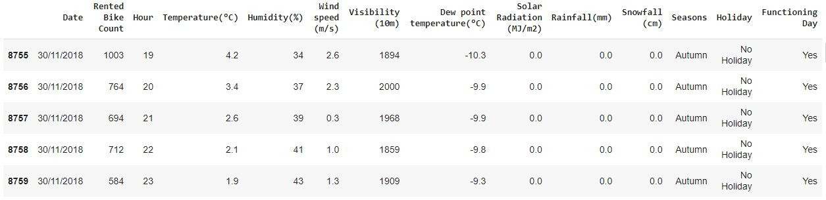
DATA SUMMARY
This Dataset contains 8760 lines and 14 columns.
Three categorical features ‘Seasons’, ‘Holiday’, & ‘Functioning Day’.
One Datetime features ‘Date’.
We have some numerical type variables such as temperature, humidity, wind, visibility, dew point temp, solar radiation, rainfall, snowfall which tells the environment conditions at that particular hour of the day.

Slide 5
FEATURE SUMMARY
Date : Year-Month-Day
Rented Bike Count - Count of bikes rented at each hour
Hour - Hour of the day
Temperature - Temperature in Celsius
Humidity - %
Wind Speed - m/s
Visibility - 10m
Dew point temperature -Celsius
Solar radiation -MJ/m2
Rainfall -mm
Snowfall -cm
Seasons -Winter, Spring, Summer, Autumn
Holiday -Holiday/No Holiday
Functional Day - NoFunc(Non Functional Hrs),Fun(Functional Hrs)

Slide 6

ANALYSIS OF OUR DATASET
There are No Missing Values present
There are No Duplicate values present
There are No null values.
And ﬁnally we have 'rented bike count' variable which we need to predict for new observations
The dataset shows hourly rental data for one year (1 December 2017 to 31 November(2018)(365 days).we consider this as a single year data
So we convert the "date" column into 3 different column i.e "year","month","day".
We change the name of some features for our convenience , they are as below 'Rented_Bike_Count', 'Hour', 'Temperature', 'Humidity', 'Wind_speed', 'Visibility', ‘Dew_point_temperature', 'Solar_Radiation', 'Rainfall', 'Snowfall', 'Seasons', 'Holiday', 'Functioning_Day', 'month','weekdays_weekend'

Slide 7
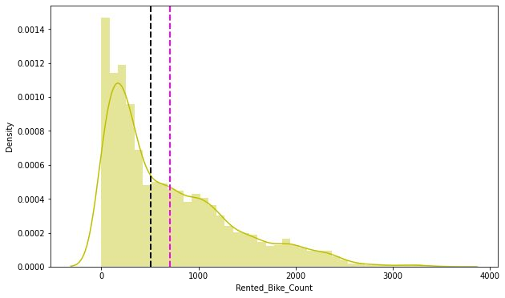
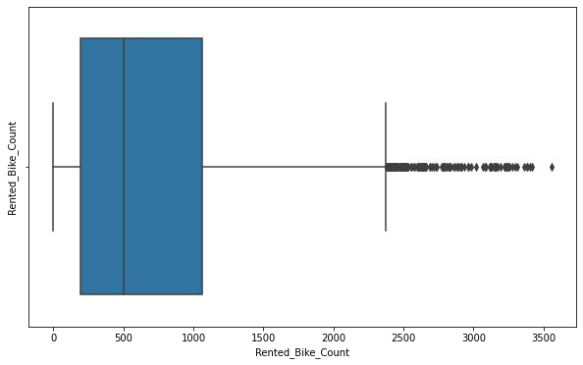
ANALYSIS OF RENTED BIKE COLUMN
The above graph shows that Rented Bike Count has moderate right skewed.
The above boxplot shows that we have detect outliers in Rented Bike Count column

Slide 8
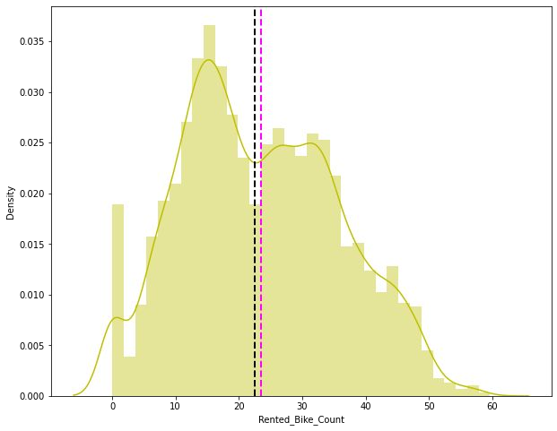
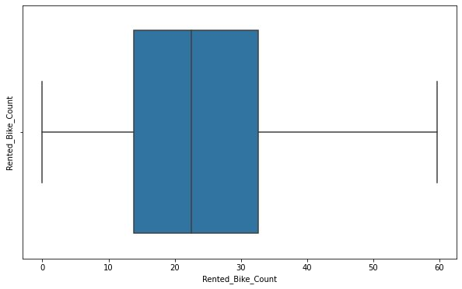
ANALYSIS OF RENTED BIKE COLUMN
After applying Square root to the skewed Rented Bike Count, here we get almost normal distribution.
After applying Square root to the Rented Bike Count column, we ﬁnd that there is no outliers present

Slide 9
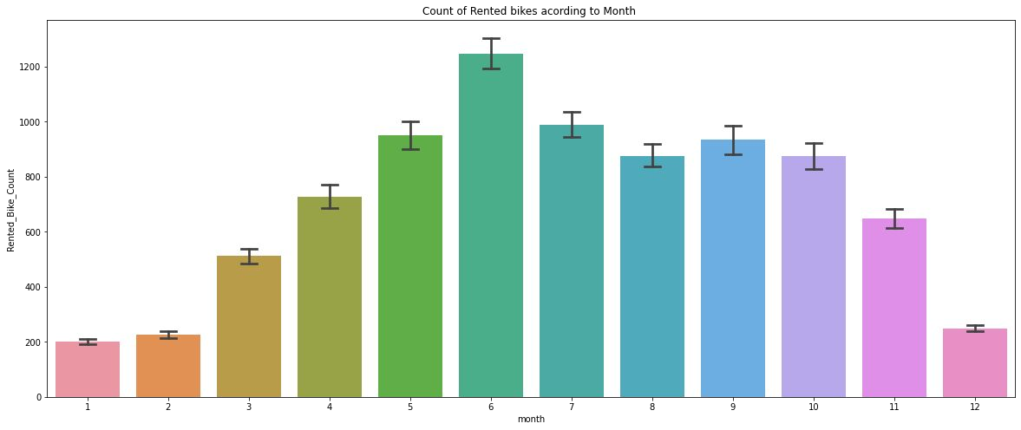
ANALYSIS OF MONTH VARIABLE
From the above bar plot we can clearly say that from the month 5 to 10 the demand of the rented bike is high as compare to other months.these months are comes belongs to the summer season.

Slide 10
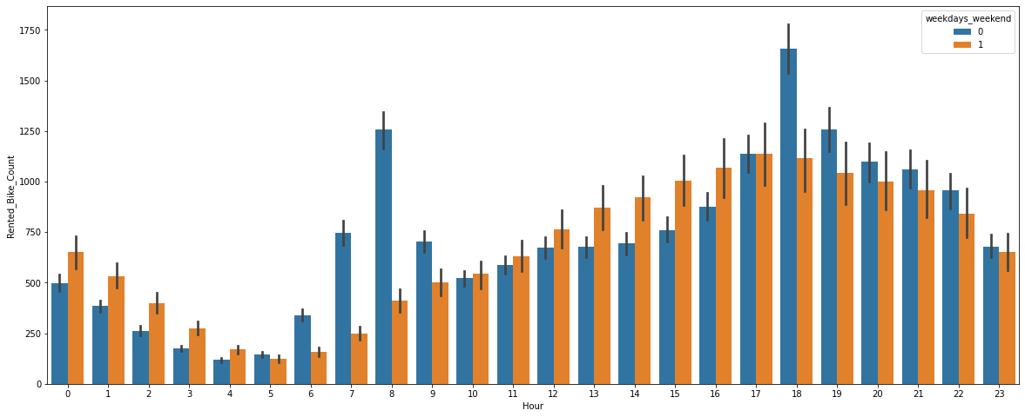
ANALYSIS OF WEEKDAYS_WEEKEND VARIABLE
From the above Bar plot we can say that in the weekdays which represent in blue colour show that the demand of the bike higher because of the ofﬁce.
Peak Time are 7 am to 9 am and 5 pm to 7 pm
The orange color represent the weekend days, and it show that the demand of rented bikes are very low especially in the morning hour but when the evening start from 4 pm to 8 pm the demand slightly increases.

Slide 11
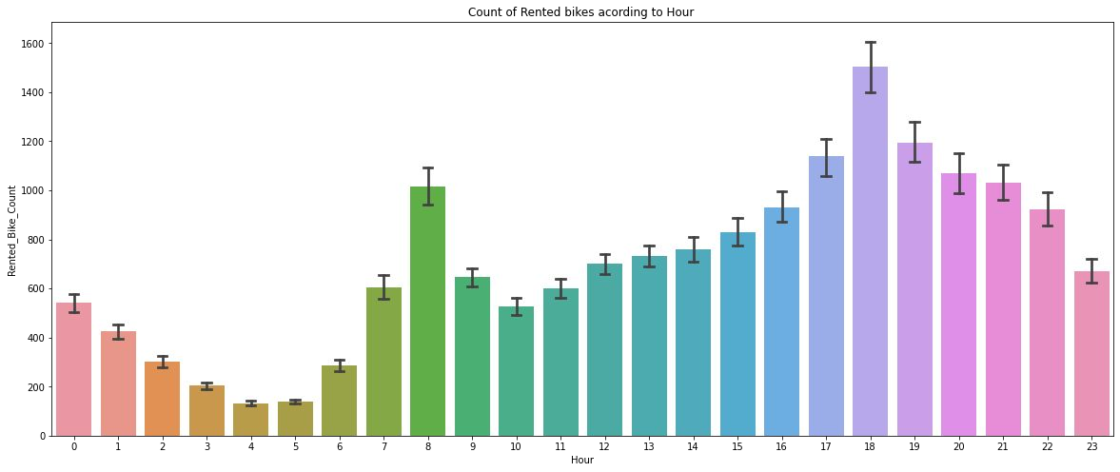
ANALYSIS OF HOUR VARIABLE
In the above plot which shows the use of rented bike according the hours and the data are from all over the year.
Most of the people use rented bikes during their working hour from 7am to 9am and 5pm to 7pm.

Slide 12
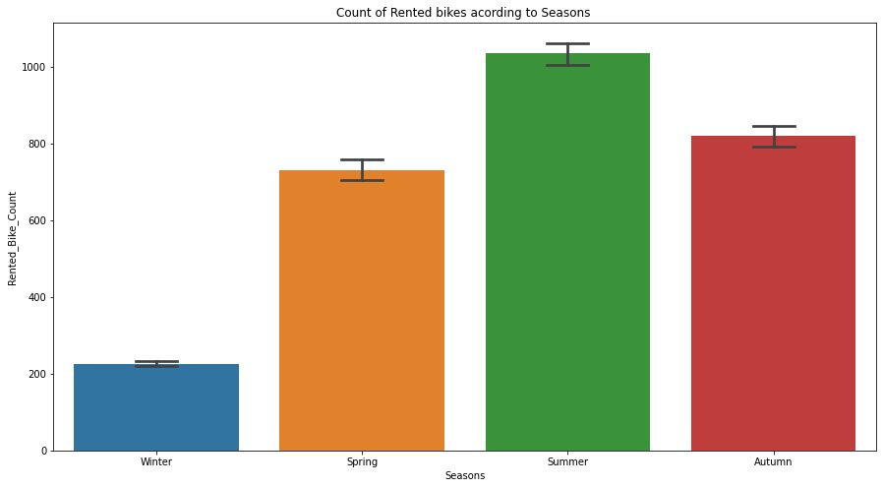
ANALYSIS OF SEASONS
This above bar plot shows the distribution of rented bike count season wise
And we can clearly see that that peoples love to ride bike in summer seasons and autumn season
But in winter season people don't take any rented bike due to snowfall

Slide 13
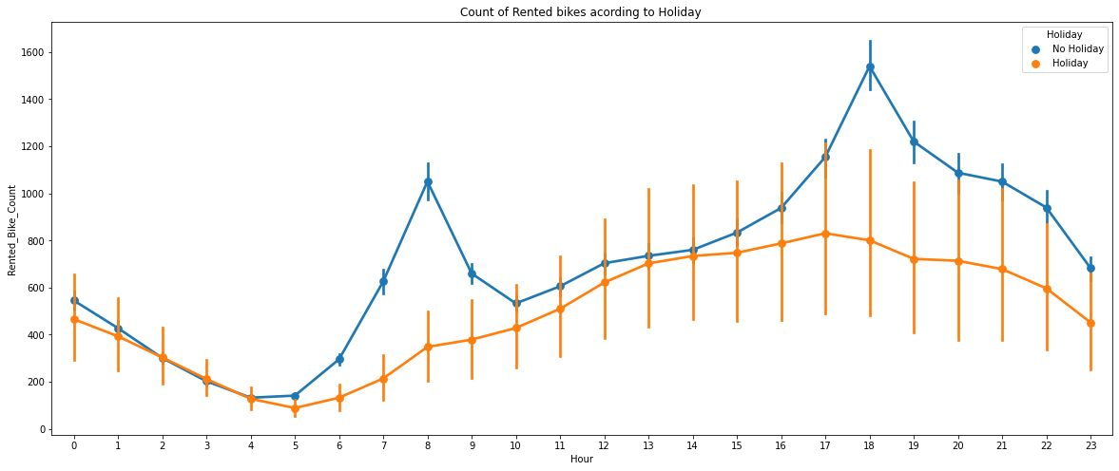
ANALYSIS OF HOLIDAY VARIABLE
In the above point plot shows that the use of rented bike in a holiday
plot shows that in holiday people uses the rented bike from 2pm-8pm

Slide 14
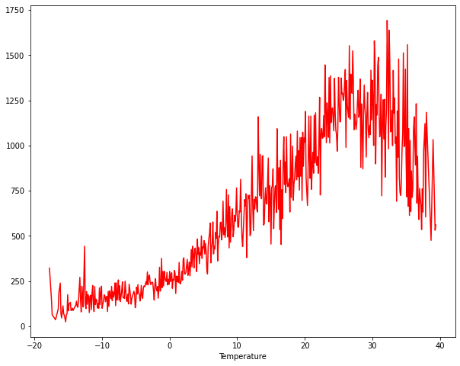
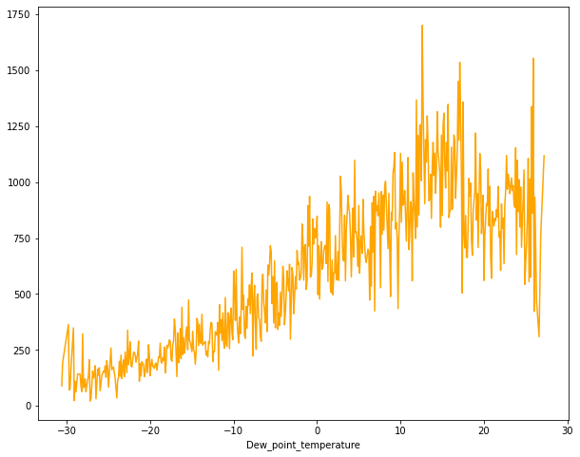
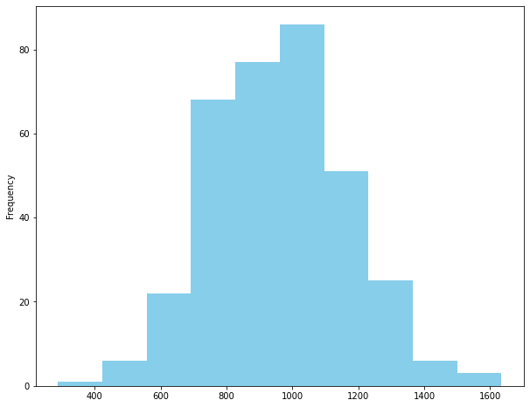
NUMERICAL VS.RENTED BIKE COUNT
From the above plot we see that people like to ride bikes when temperature is around 25°C in average
From the above plot of "Dew_point_temperature' is almost same as the 'temperature' there is some similarity present between them
from the above plot we see that, the amount of rented bikes is huge, when there is solar radiation, the counter of rents is around 1000

Slide 15
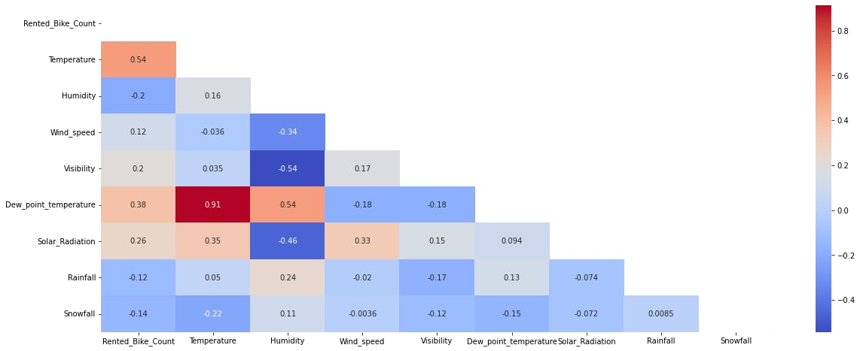
CORRELATION MATRIX
Variables like Dew Point Temperature, and Temperature are highly correlated.

Slide 16
MODEL BUILDING
LINEAR REGRESSER
GRADIENT BOOSTING REGRESSOR
GRADIENT BOOSTING REGRESSOR WITH GRIDSEARCHCV

Slide 17

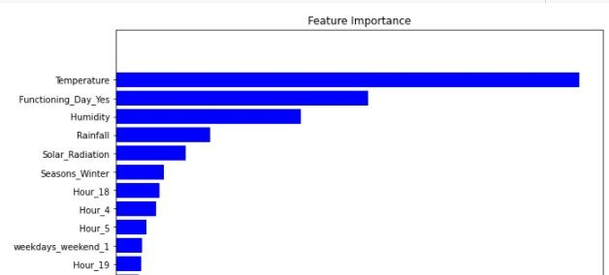

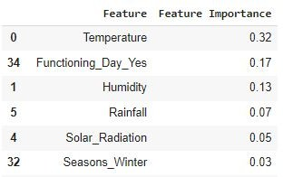
GRADIENT BOOSTING
Train Set Results
Test Set Results

Slide 18
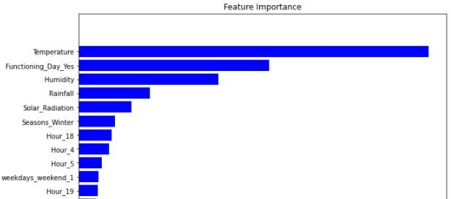


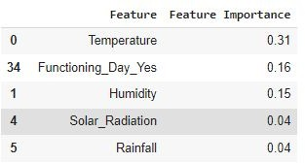

GRADIENT BOOSTING REGRESSOR WITH GRIDSEARCHCV
Train Set Results
Test Set Results
Hyper parameter

Slide 19
CHALLENGES
Large Dataset to handle.
Needs to plot lot of Graphs to analyse.
Feature engineering
Feature selection
Optimising the model
Hyperparameters tuning for better results & accuracy

Slide 20
CONCLUSION
‘Hour’ of the day holds the most important feature.
Bike rental count is mostly correlated with the time of the day as it is peak at 10 am morning and 8 pm at evening.
We observed that bike rental count is high during working days than non working day.
We see that people generally prefer to bike at moderate to high temperatures, and when little windy
It is observed that highest number bike rentals counts in Autumn & Summer seasons & the lowest in winter season. We observed that the highest number of bike rentals on a clear day and the lowest on a snowy or rainy day. We observed that with increasing humidity, the number of bike rental counts decreases.

Slide 21
THANK YOU

